Slide 1



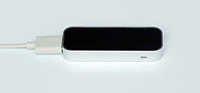
+
Assignment 1

Slide 2
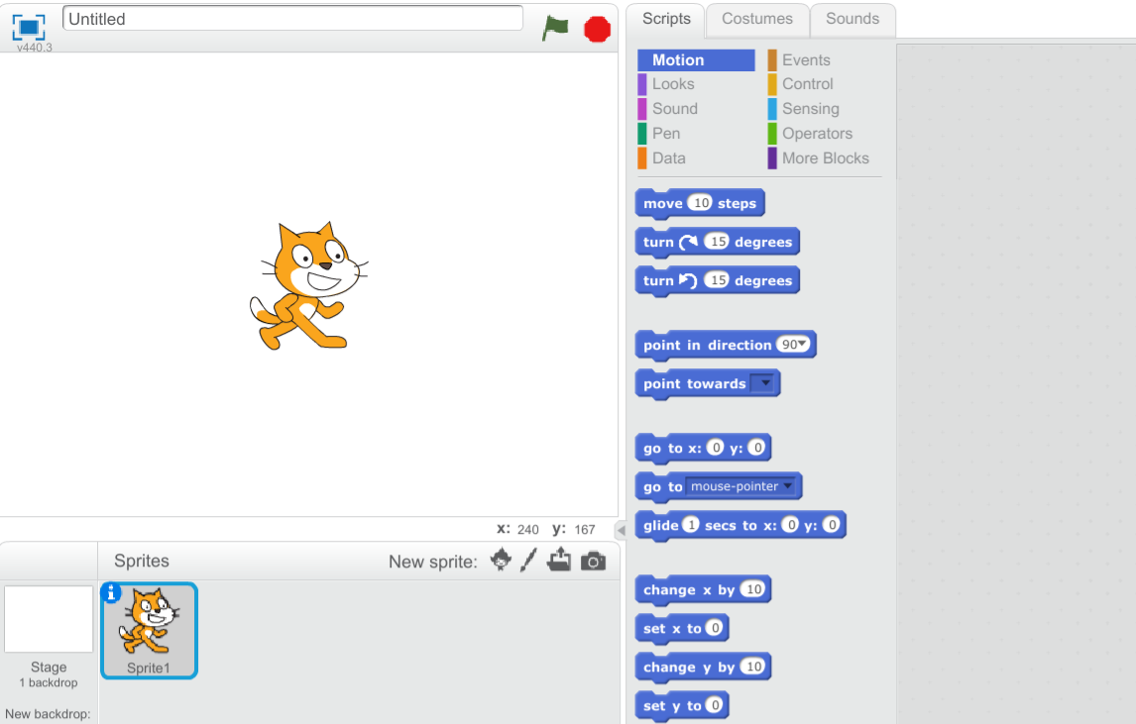
Assignment 1.1
We will start with a new project.
At the menu choose 'File' > 'New'

Slide 3
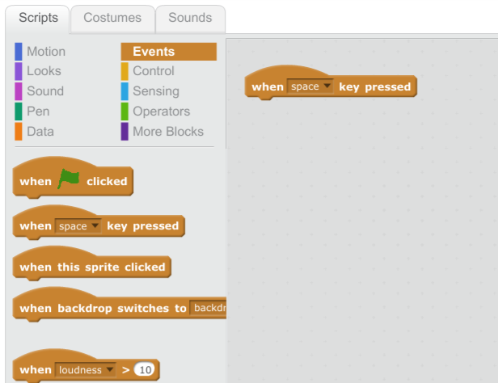
Assignment 1.2
Click on the ‘Events’ buildingblocks
Drag the ‘when space key pressed’ buildingblock to the script area.

Slide 4
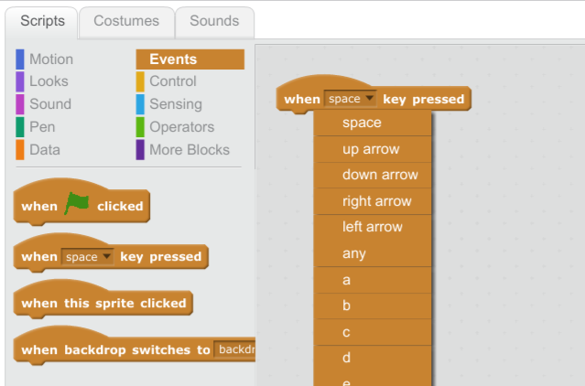
Assignment 1.3
Click on 'space' and choose 'right arrow'

Slide 5
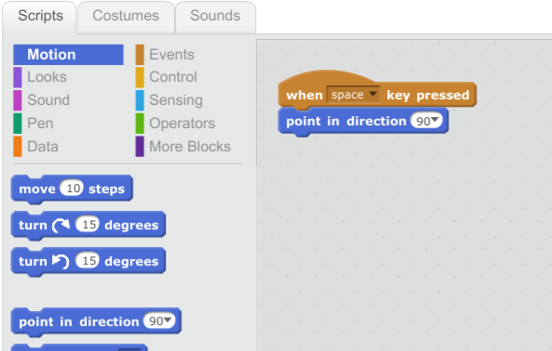
Assignment 1.4
Click on the ‘Motion’ buildingblocks.
Drag the ‘point in direction 90’ on the script area and attach it to the other buildingblock.

Slide 6
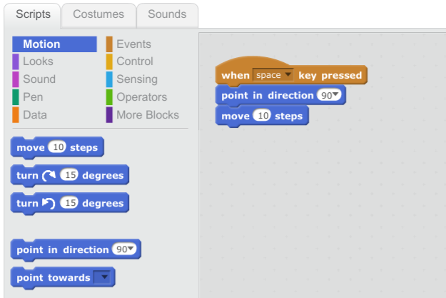
Assignment 1.5
Drag the ‘move 10 steps’ buildingblock on the script area and attach it to the other buildingblocks
When pressing the right arrow key our sprite will move 10 steps to the right

Slide 7
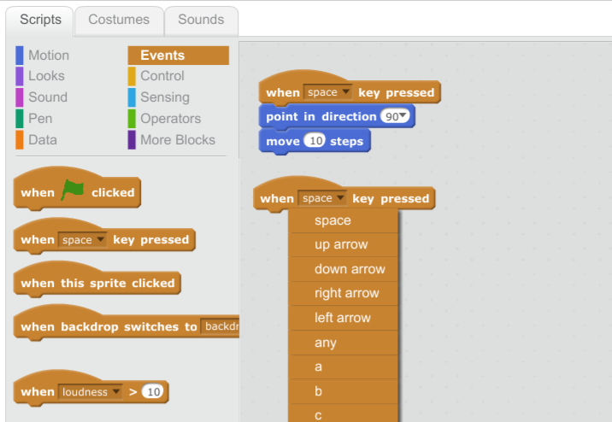
Assignment 1.6
We also want to move the sprite to the left.
Open the ‘Events’ buildingblocks.
Drag the ‘when space key pressed’ buildingblock to the script area.
Click on 'space' and choose 'right arrow'

Slide 8
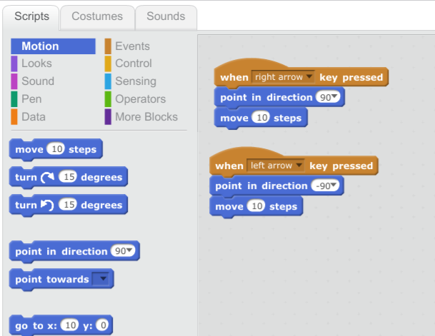
Assignment 1.7
Open the ‘Movion’ buildingblocks
Drag the ‘point in direction 90’ on the script area and attach it to the other buildingblock.
Click on '90' and select
'(-90) links'
Drag the ‘move 10 steps’ buildingblock on the script area and attach it to the other buildingblocks

Slide 9
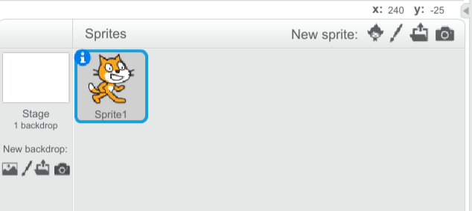
Assignment 1.8
Now we need to make sure the sprite is turning correct.
Click the blue 'I' icon at the top left of the sprite in the sprite area.

Slide 10
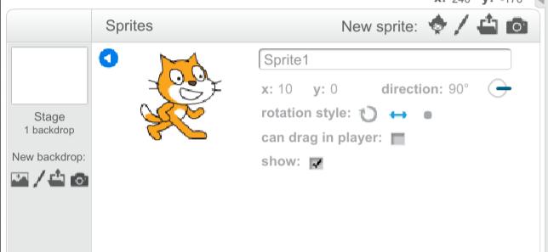
Assignment 1.9
At 'rotation style' choose the double direction arrow.

Slide 11
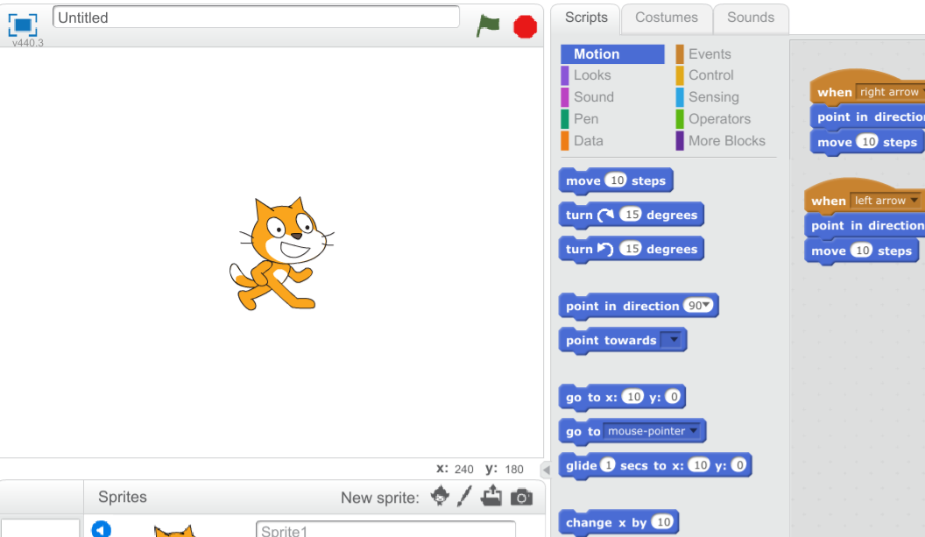
Assignment 1.10
Click the green flag at the stage area and press the 'right arrow' and 'left arrow' to move the sprite.

Slide 12
Assignment 1.11
Now try to add buildingblocks so the sprite moves
- 10 steps up when pressing the 'up arrow
- 10 steps down when pressing the 'down arrow'

